Slide 1


Combatting Fake Science Online
Hayden Estrella
Mentors: Dr. Chris Impey & Dr. Matthew Wenger, Steward Observatory
NASA Space Grant Symposium
Tempe, AZ, April 22, 2023

Slide 2

The Internet
Easy access to all sorts of information from almost anywhere in the world
There are many amazing benefits that can enhance the education of the public if used properly
However…

Slide 3
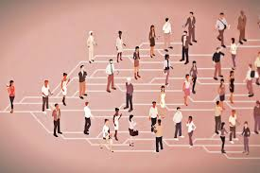
Misinformation
There is also easy access to all sorts of misinformation
Many sources easily fool their audience into believing in fake science
Spreads like a virus
Massive challenge to the scientific literacy of the public
https://www.vox.com/science-and-health/2018/3/8/17085928/fake-news-study-mit-science

Slide 4
Objective
Train a deep learning algorithm to detect whether articles online contain misinformation

Slide 5
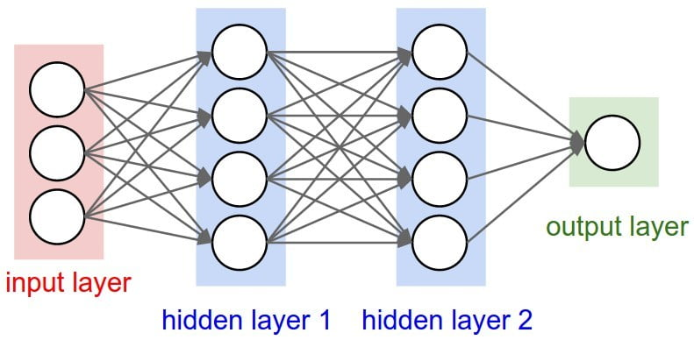
Deep Learning Algorithms
Also Known as neural networks
They are a type of Artificial Intelligence (AI) inspired by the human brain
Examples: ChatGPT, driverless cars, facial recognition
https://www.bmc.com/blogs/deep-neural-network/

Slide 6
Recent Methods
Locate articles online that discuss various fields within science
Classify the article as real or fake
Upload url and classification to app
The information from the articles are later scraped then uploaded to the AI for training, testing, and validation
1304 articles were collected using this system

Slide 7
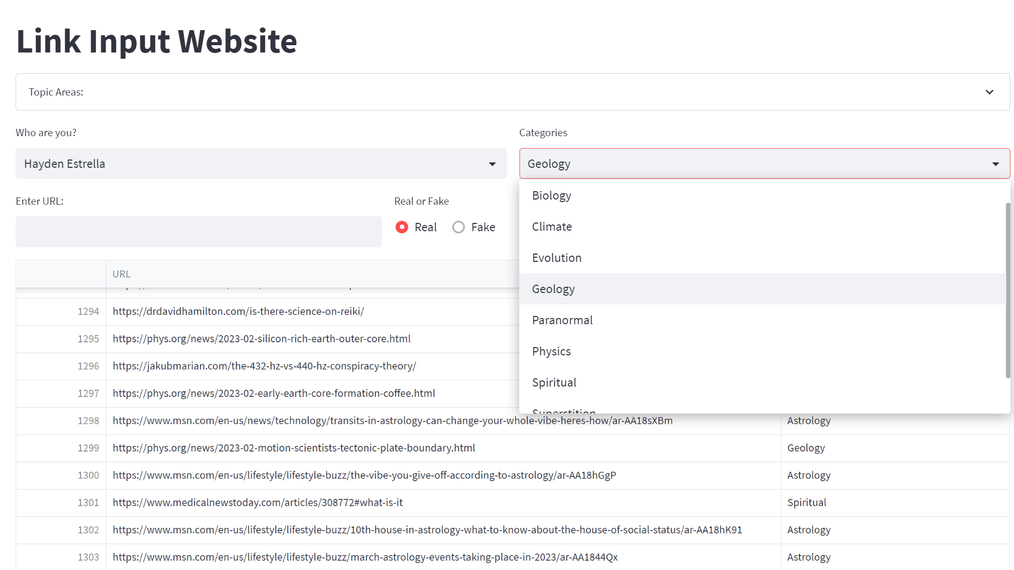

Slide 8
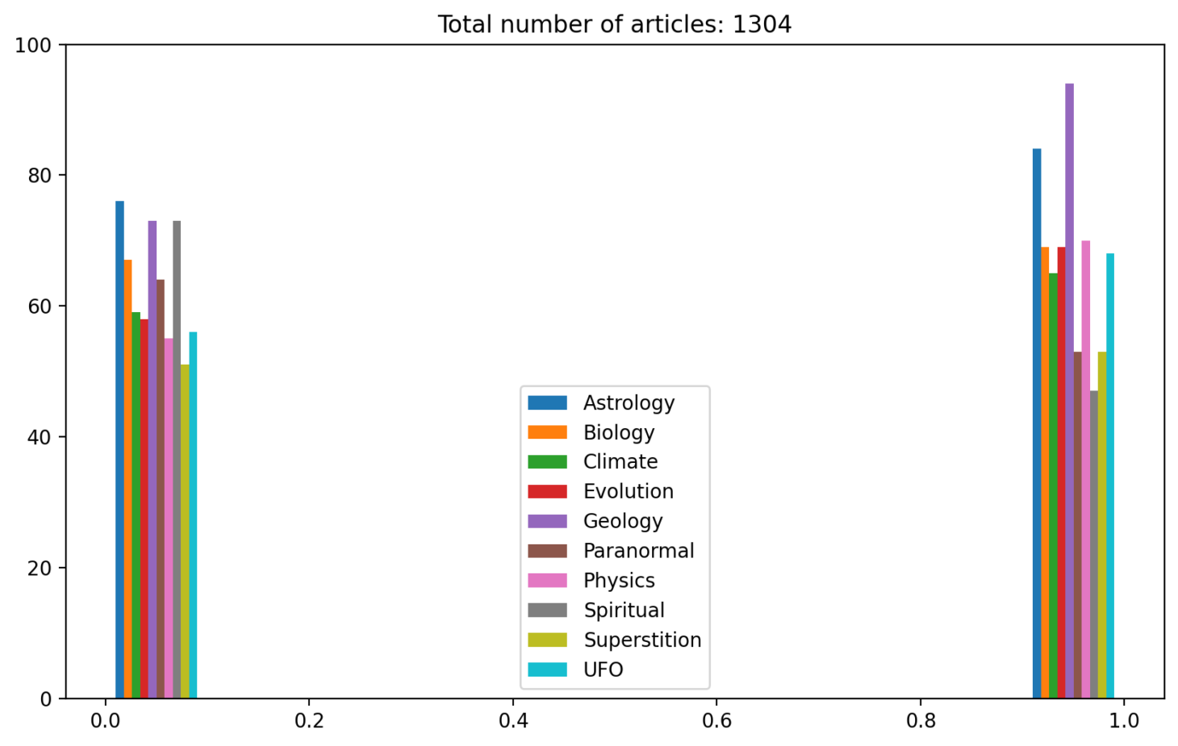

Slide 9
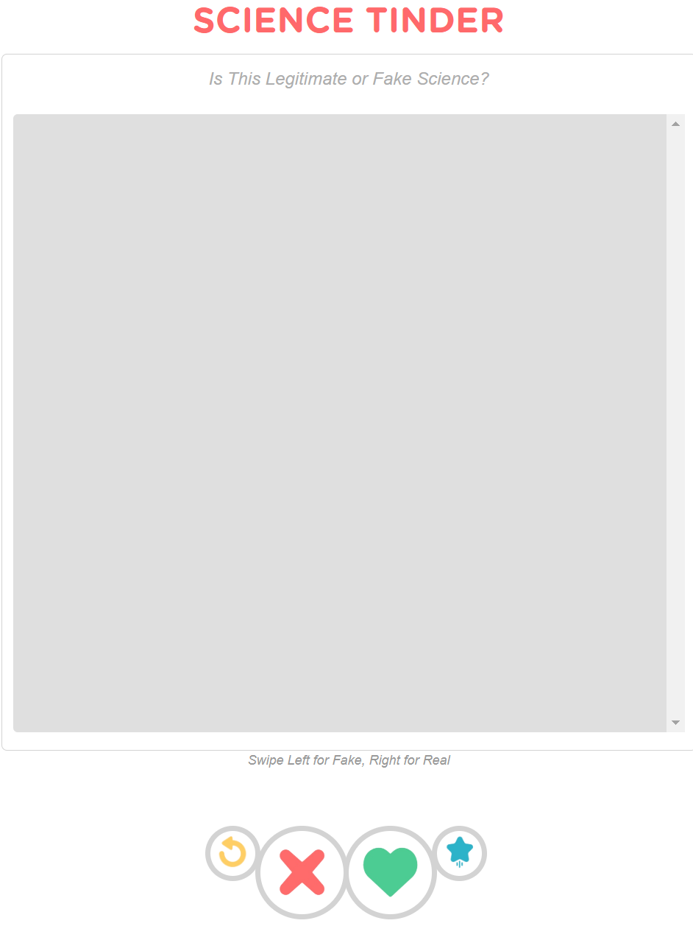
Early Work: Science Tinder
Interns would validate each other’s classifications through a tinder-like interface to ensure high accuracy
Eliminated this approach to focus on the quantity of data
Content of Web- scrapped Article would go here
Fake Button
Real Button

Slide 10
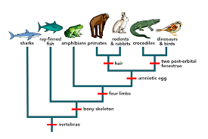
Example
Red Flags: Claims that are false, claims with faulty evidence
Example Source: Debunking Evolution by John Michael Fischer, Website - www.newgeology.us
“‘Evolution’ mixes two things together, one real, one imaginary”
“Variation (microevolution) is the real part. The types of bird beaks, the colors of moths, leg sizes, etc.”
Claim: macroevolution is imaginary
Evidence: “…there are strict limits to variation [microevolution] that are never crossed… Whenever variation is pushed to extremes by selective breeding, the line becomes sterile and dies out. And as one characteristic increases, others diminish.”
https://evolution.berkeley.edu/evolution-101/the-history-of-life-looking-at-the-patterns/

Slide 11
Results
From the articles that have been currently collected, it was able to classify them with 87% accuracy across all scientific categories
This is great considering the wide variety

Slide 12
What’s Next?
Deep learning models need A LOT of data to optimize performance
Currently searching for datasets that contain them
Goal: Collect 10s of thousands of articles across all categories
Many datasets have similar purposes for specific categories
Some datasets contain all real articles
Some contain all fake ones
This can be scaled up and become widely available for public usage in order to inform people whether they should be skeptical about the accuracy of information on websites

Slide 13
Acknowledgements
Thank you to Chris, Matthew, and everyone on the Active Galactic Team

Slide 14

THANK YOU!

